Slide 1

APPLY AT EASE
CO-FOUNDERS : Venkatesh Velagapudi
Sowmya Potla
Nikhil Reddy Baireddy
Sahiti Uppu
Ram Dixit Erra

Slide 2


Target Market and Value Propositions
Student's applications
Potential employee candidature
Stakeholders
Benefiting Stakeholders and Candidates seeking job with the background check and Students with career suggestions.

Slide 3




Trouble Spots.
1.Replications that demands lot of your time and efforts. Deciding factor of course of study for students. applications are time consuming.
3. Referencing multiple platforms for where, what and how to learn and build career
4.Repeatative background verification each time
2.Not easy to connect end user to sources as there is need for rigorous search process to find the right profile and to start the conversation

Slide 4



Fix It!!
Insights to solve the pain points:
Proposals:
From courses to job opportunities.
Saving time and efforts with a single go.
Maintaining thrift at background verification.

Slide 5


Key Winning Features & Capabilities:
Major break-through feature:
Guiding Students from scratch.
Background check:
Stakeholders & Job applicants.

Slide 6


Justification
Background Check: Cost-effective approach.
Single platform:
Students- course prediction
Job Applicants – Recommendations on current market.

Slide 7

Current Status
Project Idea Phase
Brainstorming and exploring innovative ideas that supports distributed computing.
Proposal Phase
Forming team and coming up with unique features to resolve drawbacks of existing platforms.
Design Phase
Key features, capabilities & planned implementation phase.
Analyzing existing platforms and competitors.
Implementation
Final Phase
Worked on Agile Process and developed Front end and Backend parts required for the application and testing the application after each sprint.
Developed the complete WebApp.
Registering users and duplicate validation
Revised and deployed

Slide 8
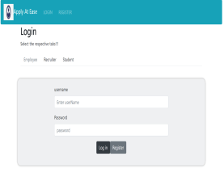
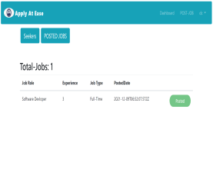
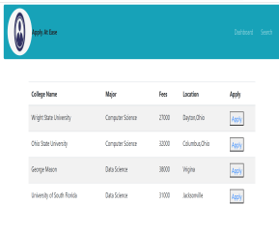
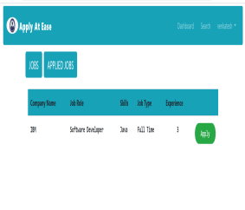
Initial Prototype

Slide 9
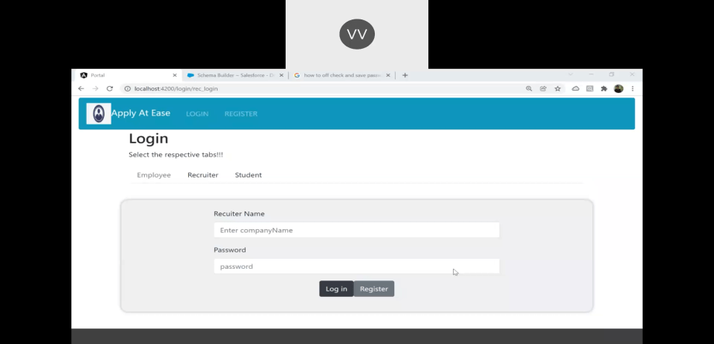
Project Demo

Slide 10


Funding Source
15-days free trial of premium membership.
Trail – pay exactly for what needed
Stakeholder’s Packages:
Posting vacancies.
Background verification.

Slide 11
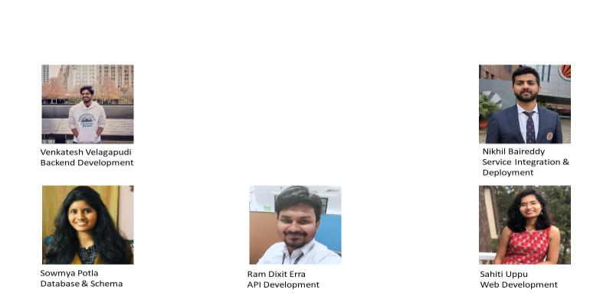
Team Members and Contribution
APPLY AT EASE

Slide 12
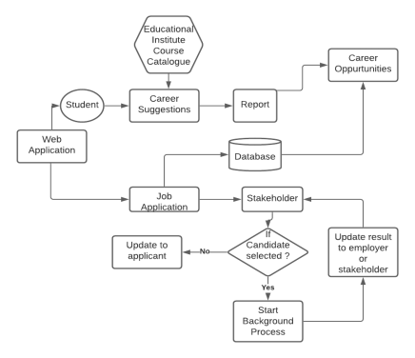
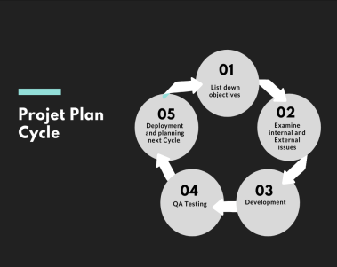
Plan For Implementation

Slide 13
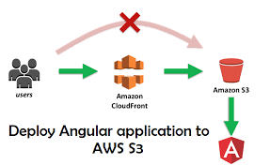

Market-entry and Scale-up
Launching our application through one of the popular platforms like AWS.
Staying up-to-date with market analysis & adding features accordingly.
Analyze the statistical data to evaluate how the webapp is being performed.
Enhancing by incorporating new capabilities and standing out unique when compared to competitors & existing platforms.

Slide 14

Thank You!

